Slide 1
Use of Waste Plastic as SLEEPER CEMENT
Name: ABHINEET AMAN
ROLL NO. : BTECH/10588/18
Branch: Mechanical Engineering
Section: B

Slide 2
introduction
The main aim of this study is to tackle the plastic waste generated in abundance throughout the world.
To gain success in this, a systematic method is employed which makes use of plastic extrude for reutilizing waste plastic into suitable construction materials.
Using only plastic waste or adding some other ingredients such as cement, fly ash, etc. plastic can be converted into useful construction materials such as pavers, railway sleepers, building blocks, etc.
Here we are going to take the help of the plastic extrusion which plays a crucial role, as it efficiently converts waste plastic into sustainable construction materials. There is no waste generated when this method is used.
In this raw plastic is melted and form into a continuous profile allowing production for various construction material.

Slide 3
Equipment required
First and foremost, we have to design an extruder. Extruder‘s design is a complex type as it involves various types of equipment . The plastic extrusion process begins with the placement of raw resin into the extruder’s hopper . Once in place, the resin is typically gravity-fed through the feed throat of the hopper down into the extruder's barrel. Within the barrel is a long, rotating screw that feeds the resin forward in the barrel towards the die.
As the resin moves along within the barrel, it is subjected to extremely high temperatures until it starts to melt.Most extruders have a barrel that gradually increases in heat from the loading end to the feed pipe to enable gradual melting and minimize the possibility of plastic degradation.

Slide 4
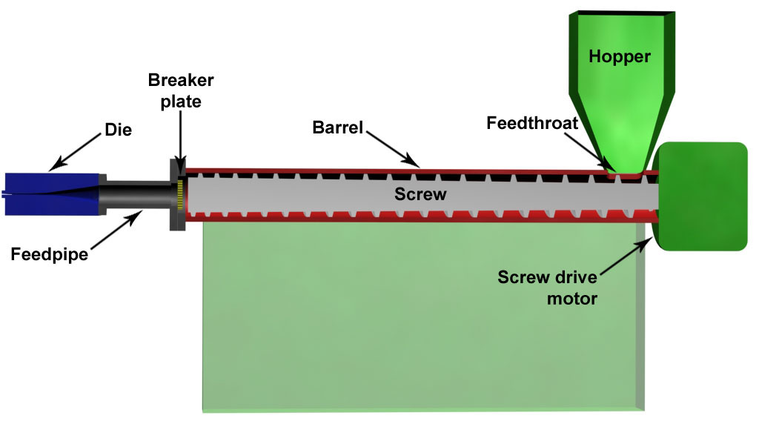
Process contd.
Once the molten plastic reaches the end of the barrel, it is forced through a screen pack and fed into the feed pipe that leads to the die. Once in the feed pipe, the molten metal is fed into the die cavity, where it cools and hardens.

Slide 5
SELECTION OF MATERIAL
The material used in the construction of machine depends on the properties of the material used. This includes, how easily can it be formed or with what ease can it be welded, its hardness, ability to resist abrasion, etc. Along with that, whether the material is economical or not and few other mechanical properties plays a major role in material selection. Materials used for the purpose of construction of machine are Barrel(having Screw conveyor inside) while the material used for the hopper is sheet metal.

Slide 6
OPERATIONS
Working principle of the machine is given below:
1. The raw plastic material is fed into the hopper. It travels by gravity to the feed throat and drops on the rotating screw. This work is carried out after switching on the heater and setting the required temperature.
2. The rotation of screw conveys the plastic forward through the heated barrel.
3. As the plastic conveys forward along the screw, the channel width keeps on decreasing which forces plastic through a smaller area.
4. This combination of compression and screw rotation causes friction which generates heat and is called as shear heating.
5. Shear heat along with barrel‘s heating system melts
plastic. The final product is collected from the end of nozzle inside a mould. After the mould is filled it is properly cooled.
6. Brick is then removed from the mould and compressive strength is tested using the universal testing machine.

Slide 7
Extruder Design Modification
The extruder design will be modified to include a cement mixing extension which will enable the machine to produce the final plastic-cement mix from the raw materials directly in a single machine.
The machine can further be fitted with wheels which shall allow for portability and ease of use.

Slide 8
STUDY OF PLASTIC BRICKS MADE FROM WASTE PLASTIC
To determine the quality and viability of using plastic based bricks we covered multiple research papers to find the optimal plastic percentage which could lend the bricks with maximum compressive strength and lower water absorption percentage.
Our objective here is to determine the highest quality plastic based construction material which could be used as a sleeper cement.

Slide 9
MIX DESIGN OF PLASTIC BRICKS
In order to find the plastic bricks that they possess high compressive strength with various mix proportions are made and they are tested using compressive testing machine (CTM).
S. No. | PLASTIC % | CEMENT (KGs) | FLYASH (KGs) | SAND (KGs) | PLASTIC (KGs)
1. | 5 | 0.992 | 4.04 | 3.078 | 0.162
2. | 10 | 0.992 | 4.04 | 2.916 | 0.324
3. | 15 | 0.992 | 4.04 | 2.754 | 0.486
4. | 20 | 0.992 | 4.04 | 2.590 | 0.648

Slide 10
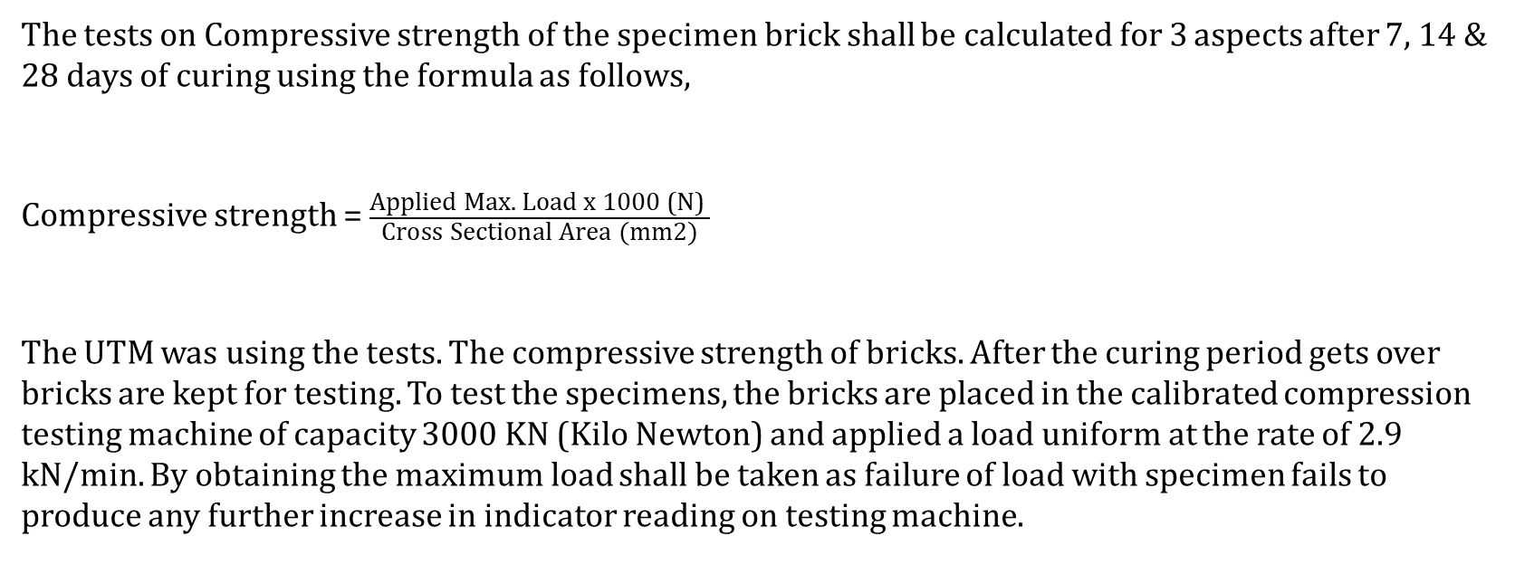
TESTS CONDUCTED ON PLASTIC BRICKS
COMPRESSIVE STRENGTH
The tests on Compressive strength of the specimen brick shall be calculated for 3 aspects after 7, 14 & 28 days of curing using the formula as follows,
Compressive strength = $\frac{\text{Applied} \text{Max}\text{. }\text{Load} \text{x}\text{ 1000 (}\text{N}\text{) }}{\text{Cross} \text{Sectional} \text{Area}\text{ (}\text{mm}\text{2)}}$
The UTM was using the tests. The compressive strength of bricks. After the curing period gets over bricks are kept for testing. To test the specimens, the bricks are placed in the calibrated compression testing machine of capacity 3000 KN (Kilo Newton) and applied a load uniform at the rate of 2.9 kN/min. By obtaining the maximum load shall be taken as failure of load with specimen fails to produce any further increase in indicator reading on testing machine.

Slide 11
COMPRESSIVE STRENGTH TEST RESULTS
SAMPLE | PLASTIC PERCENTAGE | COMPRESSIVE STRENGTH
1 | 0 | 18
2 | 5 | 18.65
3 | 10 | 19.20
4 | 15 | 20
5 | 20 | 18.4
GRAPH FOR COMPRESSIVE STRENGTH TEST RESULTS

Slide 12

WATER ABSORPTION
Bricks should not absorb water more than 12% by its weight. The bricks to be tested should be dried in an oven at a temperature of 105oC to 115oC till attains constant weight cool the bricks to room temperature and weight (W1). Immerse completely dried and weighed (W1) brick in clean water for 24 hrs. at a temperature of 27±20oC. Remove the bricks and wipe out any traces of water and weigh immediately (W2).
Water absorption in % by wt. = $\frac{W2−W1}{W1}$ x 100.
WATER ABSORPTION TEST RESULTS
SAMPLE | PLASTIC PERCENTAGE | WATER ABSORPTION
1 | 0 | 0.23
2 | 5 | 0.14
3 | 10 | 0.11
4 | 15 | 0.09
5 | 20 | 0.075
GRAPH FOR WATER ABSORPTION TEST RESULTS

Slide 13
Cost Analysis
Step 1: Cost of waste plastic (Cw) required to produce a unit amount of cement.
Step 2: Cost of making the extruder-cement mixer (E) and determining its life expectancy in terms of amount of plastic-cement produced.
Step 3: Cost of other raw materials (Cm).
Step 4: Cost of power (Cp) consumed in producing unit amount of cement.
Step 5: Total Cost of one unit of cement: Cw + Cm + Cp + E/Cement Produced.
Step 6: Cost comparisons with traditional sleeper cement.

Slide 14
CONCLUSIONS
From this research it was determined that the two most suitable choices were the 15% and 20% plastic content bricks with a compressive strength of 20 N per square millimetre and water absorption of 0.09% for the former while the latter had a compressive strength of 18.4 N per square millimetre but a lower water absorption of 0.075%.
This is the highest quality brick we have found till now.

